Slide 1
Lecture 5d: FP Addition
To watch lecture video click link below
Lecture 5d video
To view slides, continue to next slide

Slide 2
Lecture 5d: Floating Point Addition

Slide 3
How to add two FP numbers?
Let’s review how we do in decimals
Example: 9.986 * 10³ + 7.836 * 10²
Step 1: Align exponents (shift the number with smaller exponent)
9.986 * 10³ + 0.7836 * 10³
Step 2: Add fractions
9.986 + 0.7836 = 10.7696
(i.e. 10.7696 * 10³)
Step 3: Normalize the sum
10.7696 * 10³ => 1.07696 * 10⁴
Step 4: Rounding
1.07696 * 10⁴ => 1.0770 * 10⁴
Why shift the number with smaller exponent, not the one with larger exponent?

Slide 4
Floating Point Addition
Addition of FP in binary is the same as that of decimal values
Here we assume adding two positive FP numbers.
Algorithm idea
Step 1: shift the fraction of the one with smaller exponent (Exponent compare, shift/alignment)
Step 2: add the fractions
Step 3: normalize the sum
Step 4: round the sum
Example
Flowchart
In this class, we will ignore the discussion of Exception, as well as the need for “re-normalization” caused by “rounding”.

Slide 5
FP Addition in Binary
Same as in decimal
Example
1.11011 * 2² + 1.01011 * 2⁻¹
Step 1: Exponent compare, shift/alignment
1.11011 * 2² + 0.00101011 * 2²
Step 2: add
1.11011 * 2² + 0.00101011 * 2² = 10.000000011 * 2²
Step 3: normalize
10.000000011 * 2² => 1.0000000011* 2³
Step 4: round
1.0000000011* 2³ => 1.00000 * 2³

Slide 6
FP Addition of IEEE 754 numbers
0 10000001 1101 1000 0000 0000 0000 000 (1.11011 * 2²)
+ 0 01111110 0101 1000 0000 0000 0000 000 (1.01011 * 2⁻¹)
Step 1: Exponent compare, shift/alignment
10000001 - 01111110 = 3₁₀
2nd number shift right 3 times (note: must recover hidden 1)
1 01011000000000000000000 => 000101011000000000000000000
Step 2: add (with hidden 1 recovered)
111011000 0000 0000 0000 000 + 000101011 000000000000000000
=> 10 00000011 000000000000000000
Step 3: normalize
10 0000001100 … 0 => 1 0000001100…00
exponent: 10000001 + 1 => 10000010
Step 4: round
1 00000011 000000000000000000 => 1 0000 0011 0000 0000 0000 000
Final result: 0 10000010 0000 0011 0000 0000 0000 000

Slide 7
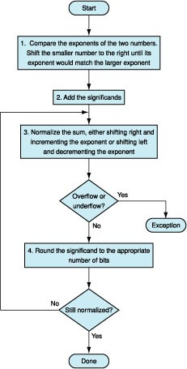
FP Addition Algorithm: Flowchart
ignored
ignored
zyBook Figure 3.5.2

Slide 8
How we implement FP addition algorithm?
Task
Build a hardware unit that implements FP addition
FP numbers represented in IEEE 754 single precision
Hardware diagram
Next slide (zyBook Figure 3.5.3)
What we should know from the diagram?
Input and output format
How it performs Step 1 and step 2 of addition?
Will ignore step 3 and step 4
Details about the hardware diagram omitted.

Slide 9
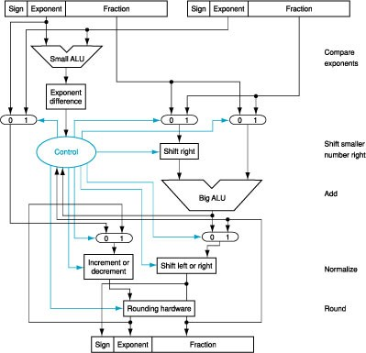
FP Addition Hardware Diagram
zyBook Figure 3.5.3

Slide 10
FP Subtraction
The hardware diagram (with minor modification) can actually perform FP subtraction
In the diagram the sign of two input data is not connected to the output’s sign.
We can use a – b => a + (-b) if we deal with signs properly.
Details omitted here.

Slide 11
Overflow and Underflow
During the addition, overflow and underflow may occur.
Could you give an example, i.e. give two FP numbers a and b such that a + b would have an overflow?
Overflow: a = ? b = ? (note: many possible a’s and b’s.)
(Review Overflow/Underflow definition in Lecture 5c. More to discuss at Lecture 5e FP Multiplication.)

Slide 12
Floating Point Complexities
Accuracy can be a big problem
May not be associative
x+(y+z)= -1.5*10³⁸+(1.5*10³⁸+1.0)= -1.5*10³⁸+1.5*10³⁸=0
(x+y)+z=(-1.5*10³⁸+1.5*10³⁸)+1.0=0+1.0=1.0
Limited accuracy
IEEE 754 keeps two extra bits, guard and round during addition
Other complexities
positive divided by zero yields “infinity”
zero divide by zero yields “not a number”
Standard
Implementing the standard can be tricky
Not using the standard can be even worse
Pitfalls
see zyBook 3.9 for description of 80x86 and Pentium bug!
Optional, not for credit.

